Slide 1
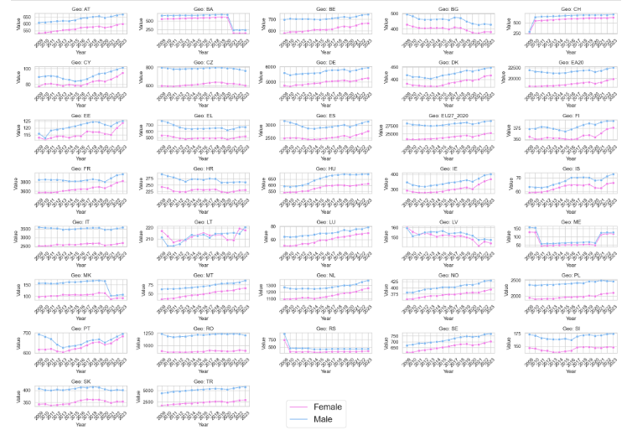
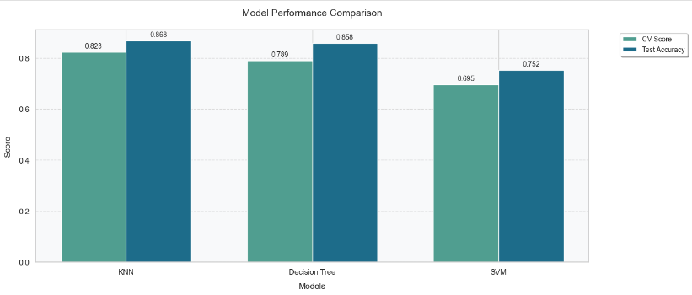
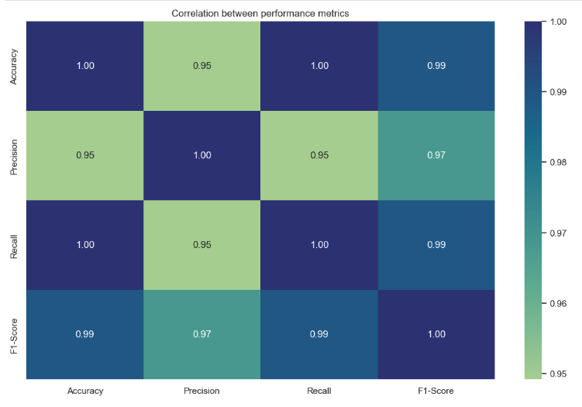
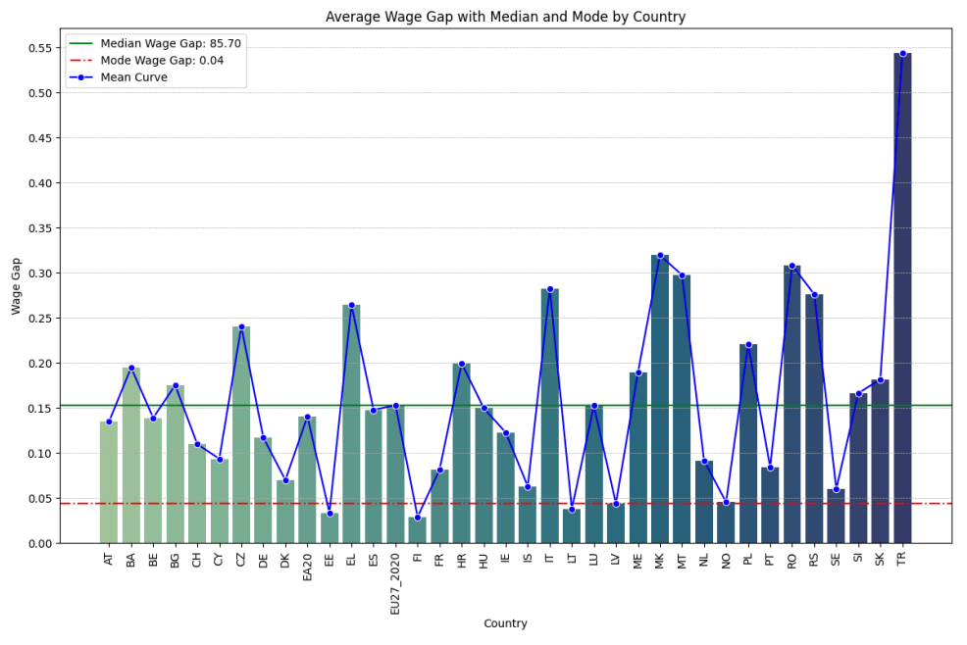
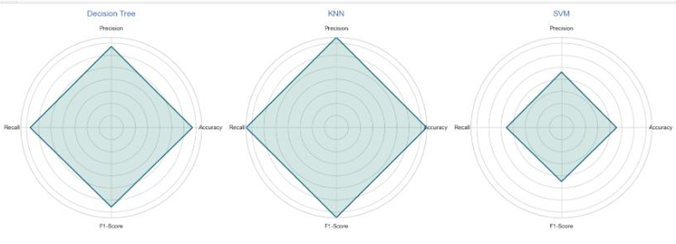
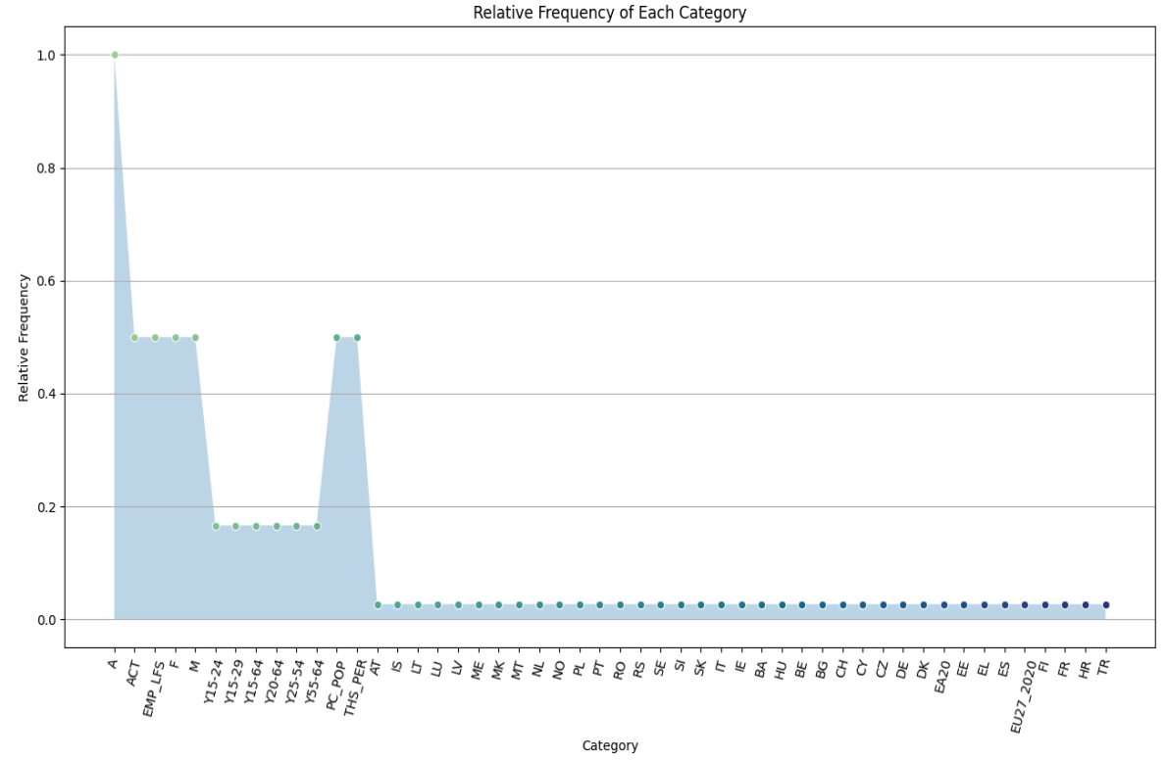

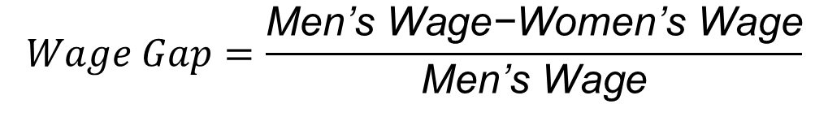
EXPLORING THE GENDER WAGE GAP IN EUROPE: PREDICTIVE MODELING USING KNN, CART, AND SVC
Yumiko Bejarano, CCT College Dublin / University of Hertfordshire, May 2019
INTRODUCTION
CHALLENGES ENCOUNTERED
Additional Cross-Validation
The gender wage gap remains a persistent issue across Europe, where disparities in income between men and women are evident. This project uses a machine learning approach to examine wage differences across various demographics using Eurostat data. The goal is to identify and analyze the factors contributing to these to promote gender equity in the workforce.
Data Quality: Missing values and outliers handled with imputation and filtering; rows with less than 85% completeness removed.
Class Imbalance: Techniques like SMOTE were used to balance wage categories, improving model performance on minority classes.
High Dimensionality: Feature selection using correlation, SelectKBest, and Lasso regularization to improve model efficiency.
Overfitting: Cross-validation and hyperparameter tuning, along with Decision Tree pruning, helped maintain model generalizability.
An additional cross-validation confirmed KNN’s high consistency and stability across folds, reinforcing its reliability in wage gap prediction. The Decision Tree showed variability, highlighting some overfitting, while SVM remained moderately consistent but generally underperformed. This validation underscores KNN’s robustness for accurate wage gap analysis.
Model Performance Comparison
RESULTS AND ANALYSIS
In comparing model performance, the K-Nearest Neighbors (KNN) model proved the most effective for predicting wage gaps, achieving an accuracy of 86.76% with balanced precision and recall, indicating strong generalizability and minimal overfitting. The Decision Tree model stability and struggled particularly in handling complex patterns in wage data. Overall, KNN demonstrated the best balance between accuracy and consistency across wage gap categories, making it the most suitable model for addressing the complexities of wage disparity analysis.
Exploratory Data Analysis (EDA)
The dataset comprises a balanced distribution of categorical variables like gender (50% male, 50% female) and employment indicators. Numerical data reveals a in recent years. This stability in mean and median salaries supports more relable comparisons post-2009. Charts displaying categorical distributions and mean salary trends over time highlight these insights.
BUSINESS DESCRIPTION
This study explores wage disparities between men and women in Europe through data analysis, using the Eurostat dataset to uncover factors driving income inequality and suggesting strategies % accuracy in predicting wage disparities.
Data Completeness: Ensuring data gaps are below 15% after cleaning and imputation.
Bias Reduction: Achieving balanced representation across wage categories through class balancing techniques.
Feature Selection
Feature selection involved techniques like Correlation, Univariate Selection, Lasso Regularization, and Recursive Feature Elimination (RFE). Lasso and RFE effectively identified the most predictive features, improving model training efficiency. A bar chart visualized the selected features, displaying their importance scores and relevance across the different methods for easy interpretation.
TECHNOLOGIES USED
Boxplots for Outliers
Models
K-Nearest Neighbors (KNN): Classifies and predicts wage disparities based on similarity.
Machine Learning Algorithms
Three models (KNN, CART, SVC) provide comparative insights on wage disparity predictions.
Optimization
Cross-Validation: 5-fold to ensure robust model performance.
Hyperparameter Tuning: Adjusted key parameters in each model for improved accuracy.
Outlier analysis shows substantial data variability from 2003 to 2004, but as data concentration improves from 2005, the number of outliers reduces. This trend indicates increased consistency in recent years. Boxplots of wage distributions over time reveal how variability has evolved, supporting more accurate wage comparisons in later periods.
CONCLUSIONS
Superior Performance of KNN Model
The KNN model proved to be the most effective and reliable for predicting wage disparities, showing high accuracy (86.76%), balanced precision, and robust generalizability across low, medium, and high wage gap categories.
Model Comparison Highlig\hts
Decision Tree: Achieved competitive accuracy but exhibited overfitting, especially in the medium wage gap category, leading to increased variance in predictions.
SVM: Displayed moderate consistency but struggled with complex data patterns, disparities that need to be addressed.
, organizations can take actionable steps to close the gender wage gap.
Modeling and Evaluation
In predictive modeling, K-Nearest Neighbors (KNN) with k=5k = 5k=5 was the most successful, reaching an accuracy of 86.76% with well-balanced precision and recall. The Decision Tree model achieved an accuracy of 85.82% at a depth of 7 but showed some overfitting. These findings suggest KNN as a robust model for predicting wage gaps, with radar charts highlighting the comparative performance of each model.
Wage Gap Analysis
WHAT HAS BEEN ACCOMPLISHED SO FAR
The wage gap analysis demonstrates a persistent trend where women generally earn less than men across countries and years. This disparity is captured in an average wage gap of 15.9% between genders, calculated as the difference between men’s and women’s wages divided by men’s wages. Line charts illustrating wage trends for both genders underscore the need for addressing systemic gender wage disparities across regions.
Data
Dataset: 1776 samples with 27 variables from Eurostat, covering demographics, employment, and wages.
Attributes: Gender, age, employment status, region, wage info, and frequency.
Descriptive Stats: Average salaries show a wage gap; gender distribution is balanced.
Visualization: Charts and heatmaps reveal trends and outliers.
Preparation: Imputed missing values, encoded categories, and scaled features.
Models
Trained and evaluated KNN, CART, and SVC to identify top performers for wage gap predictions.
REFERENCES
Chapman, P., Clinton, J., Kerber, R., Khabaza, T., Reinartz, T., Shearer, C. and Wirth, R. (2000). Step-by-step data mining guide. [online] Available at: https://www.the-modeling-agency.com/crisp-dm.pdf.
Chatgpt.com. (2024). Available at: https://chatgpt.com/share/681cfb33-4726-43ca-8d24-3a2431901e84 Get instant answers, find inspiration, learn something new.
Kazil, J. and Jarmul, K. (2016). Data Wrangling with Python: Tips and Tools to Make Your Life Easier. [online] Google Books. ‘O’Reilly Media, Inc.’ Available at: https://books.google.ie/books?id=XmeDCwAAQBAJ&printsec=copyright&redir_esc=y#v=onepage&q&f=false [Accessed 22 May 2024].
Müller, A.C. and Guido, S. (2017). Introduction to machine learning with Python : a guide for data scientists. Beijing: O’reilly.
Peng, R.D. and Matsui, E. (2015). The art of data science : a guide for anyone who works with data. Victoria, British Columbia: Lulu.com.
Python, R. (n.d.). Using k-Nearest Neighbors (kNN) in Python – Real Python. [online] realpython.com. Available at: https://realpython.com/courses/knn-python/ [Accessed 22 May 2024].
VanderPlas, J. (n.d.). Handling Missing Data | Python Data Science Handbook. [online] jakevdp.github.io. Available at: https://jakevdp.github.io/PythonDataScienceHandbook/03.04-missing-values.html.
Key Formula:
$$Wage Gap=\frac{\text{Men}\text{’}\text{s} \text{Wage}\text{−}\text{Women}\text{’}\text{s} \text{Wage}}{\text{Men}\text{’}\text{s} \text{Wage}}$$

